Slide 1
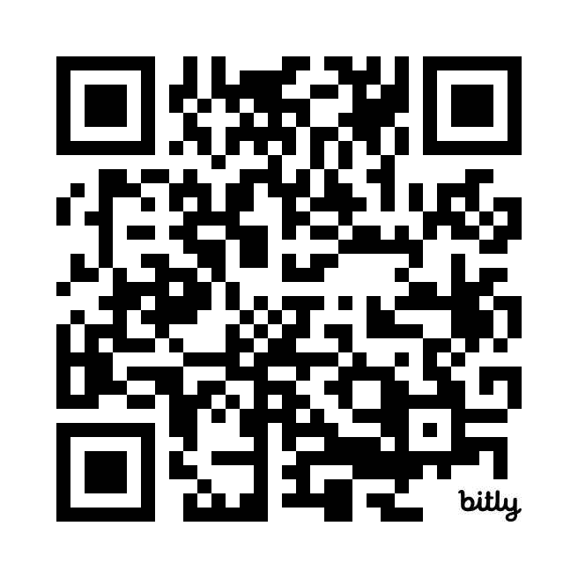
Software Requirements Elicitation Quiz
https://bit.ly/3vnfirt

